Slide 1

Waterproof Motivation Enhancer Kit
Alyn-Intel MakeAthon
March 2016

Slide 2
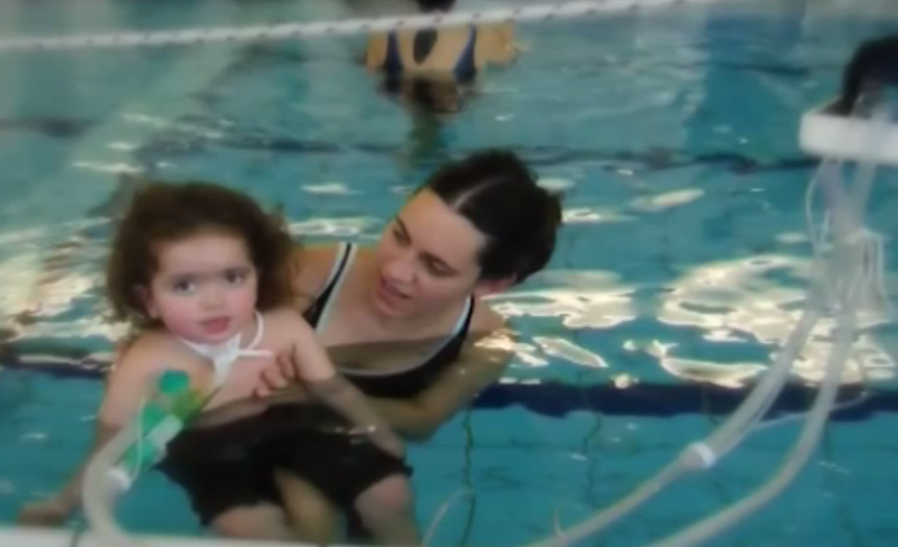
One of the three key Alyn principles is that every child – even those connected to respirator machines, spends time in the hydrotherapy pool.
The water supports the weight of the child’s body, and they are able perform exercises – such as moving their legs, that they could not do otherwise.
After weeks of such exercises, the child may be ready to take their first steps out of the water.
How can therapists motivate children to perform these first exercises in the water?
Children are encouraged to perform arm exercises by feeding pets. What can we do here?
Can we provide automatic feedback and automatic goal extension?

Slide 3
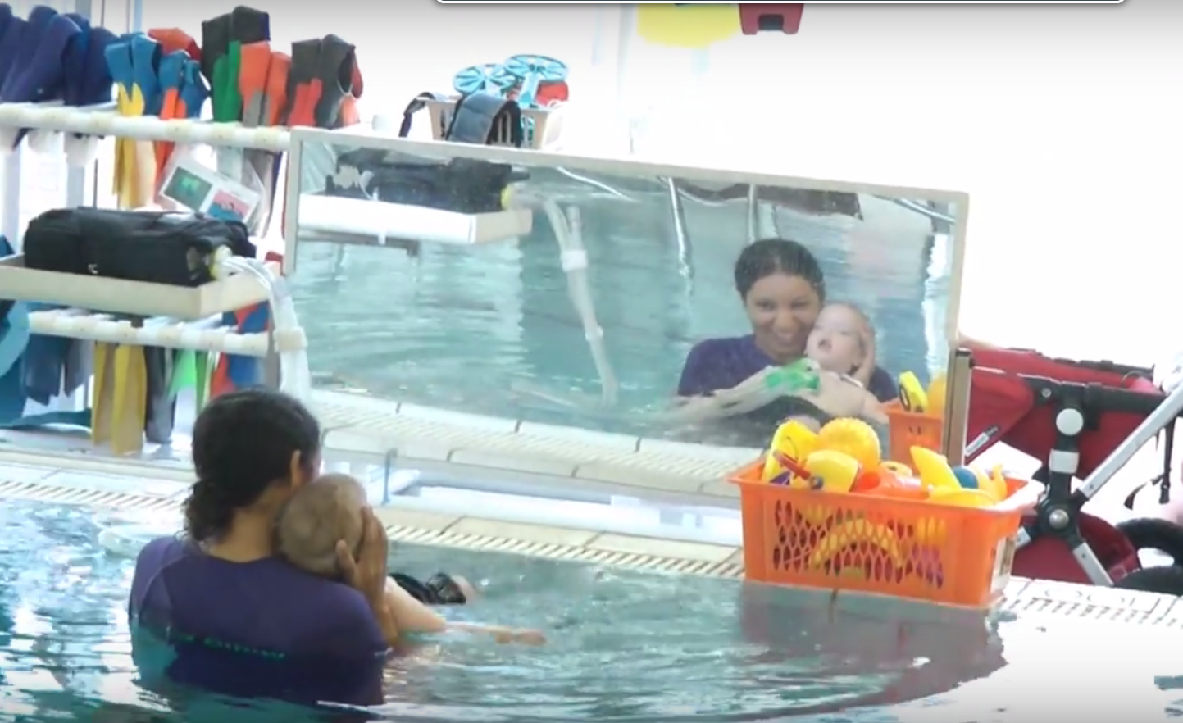
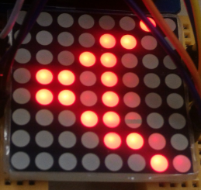
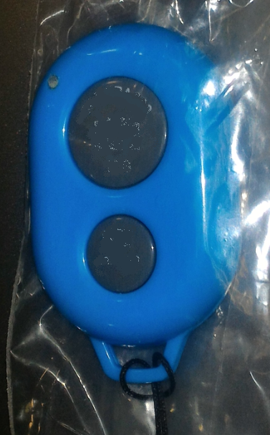
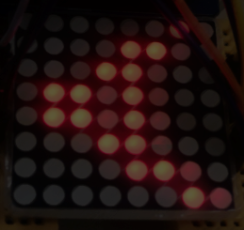
Concept
Sensor
Feedback

Slide 4
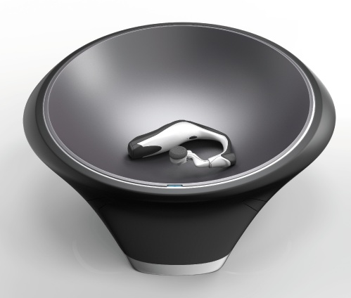

One Table
Product Phase | Sensor | Feedback
Final | Three-axis motion detecting wrist-band | Floating ball with animation
Interim | Therapist-operated push-button | Floating ball with animation
Initial | Learning ‘hit me’ ball with responsive animation
Demo | Learning ‘hit me’ device with basic responsive animation
IP68
Fully waterproof
Inductive charging
Data upload via Wifi

Slide 5
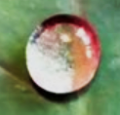
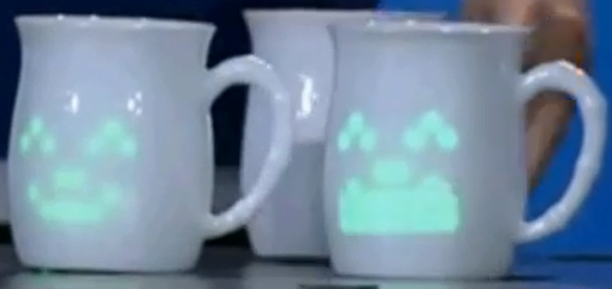
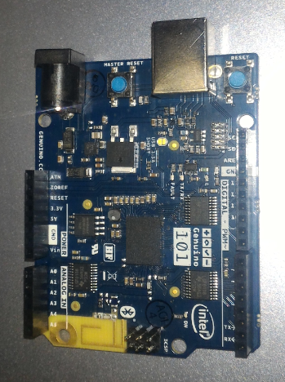
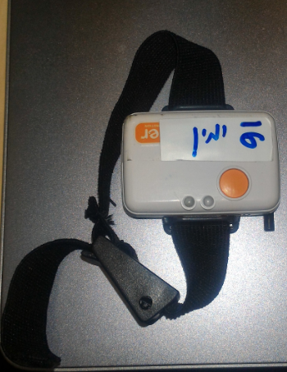
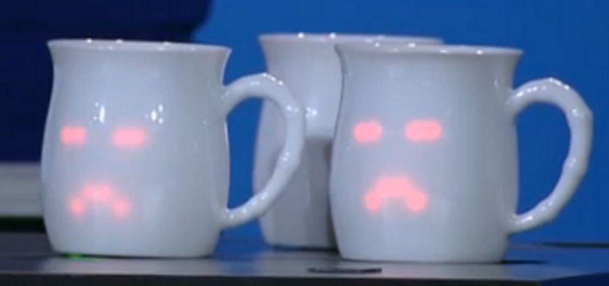
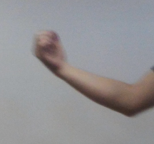
Intel has the technology to do this

Slide 6
Adaptive goal raising
Initially, goal set low, encouraging child to learn the activity.
Child received positive response each time goal is met or exceeded.
After goal has been exceeded three times in succession, goal is raised to the lowest of those three… …and will not be raised for at least a further five times.

Slide 8
More ideas
2 balls
Instructor moves the ball and trainee requested to repeat the motion with another ball
Light organ as a feedback for success
Connected with Bluetooth to the ball

